Slide 1

Kennis Netwerk Water Workshop, 18th March 2026 Space based local Water Quantity monitoring for Water Quality indicators
Hans van Leeuwen, PhD (STOWA/SAT-WATER NL)
PI-PCP-WISE

Slide 2
What Europe/NL needs is a daily Soil-Water-Vegetation conditions message (in addition to the weather message!) to anticipate on extreme conditions in local rural and urban living environment!!

Slide 3
PCP-WISE programme focus on Local Acting level !
The water distribution in European River basins is of transnational importance in this era of dynamic climate change.
On top of that there is a huge pressure on the wateravailability by numerous sectors (industry, agriculture, nature, consumption, etc).
The consequences of local shortage or abundance of water in our soils (groundwater and acquifer systems) and surface waters are increasing and result in extreme situations to flooding, wildfires, waterquality, productivity, etc. problems.
The current European climate tools available give relevant insight in the large scale tendencies on these water related issues, but are too generic (but serve as relevant boundary conditions) for local and operational management.
With PCP-WISE we can complement these existing services and support local (100m) operational measures in the context of national and European frameworks of climate adaptation and mitigation

Slide 4



Watermanagement in the Netherlands
The watermanagers in the NL face a huge challenge in 2027 to comply to the European Water Framework directive!
Stelling:
A sound monitor of your basic soil-water-vegetation system conditions in quantitative terms is required to assess your water quality.

Slide 5
Kennis Network Water as a catalist
The KNW research network (with a triple helix approach) could facilitate water managers by developing prioritised solutions in this case on waterquality issues.
An important research aspect of KNW is studying water quality of small water channels by developing a remote sensing/model/AI based approach
in order complement and support local waterquality assessment traditionally done by taking field samples and lab analysis
By working together as government (waterauthorities, central government), researchers and companies KNW could make a difference

Slide 6
Remote sensing as a smart instrument to support WFD
Remote sensing applications have already proven to support water quality assessment especially with respect to monitor aquatic ecological indicators (watervegetation, and suspended matter, etc). At the DG-JRC these are already recongnised and proposed contributions to the formal reporting of the WFD mechanism.
Remote sensing can (in)directly also contribute as a monitor and with actualising the quantative conditions of our soil-water systems, in open water and ground water systems, especially in prolonged dry periods. These dry conditions impose additional pressure on our SWV systems when the concentrations of chemical substances will increase.
It supports the local inspection and waterquality assessment and reporting in the field by focusing on the hotspot of waterquality problems.

Slide 7
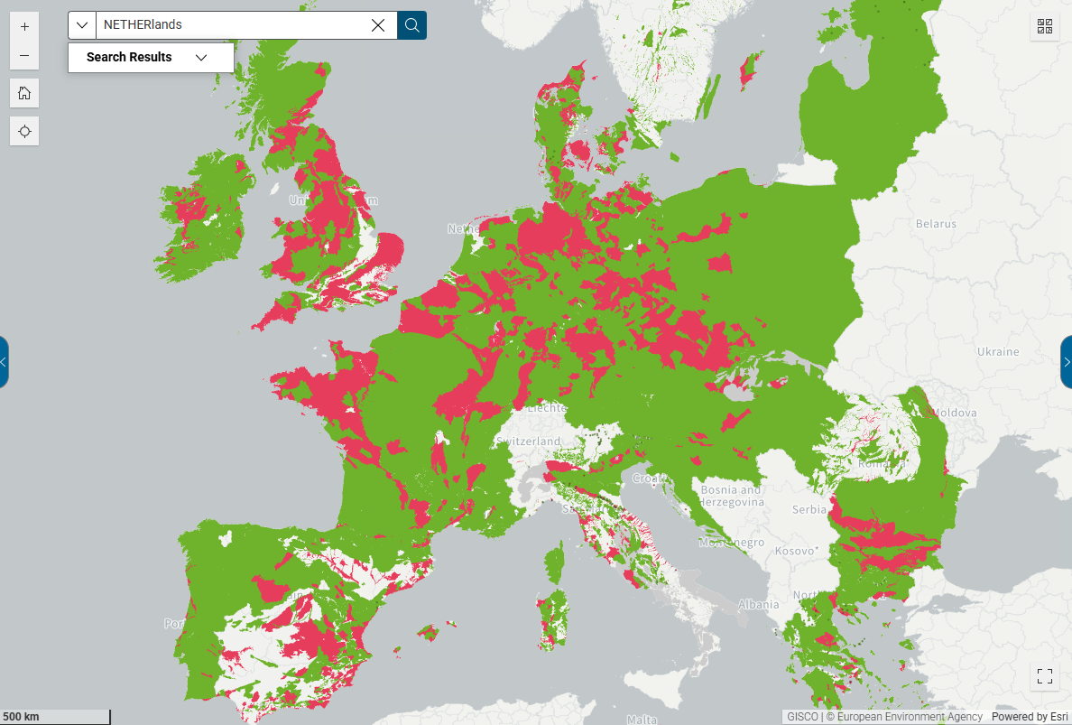
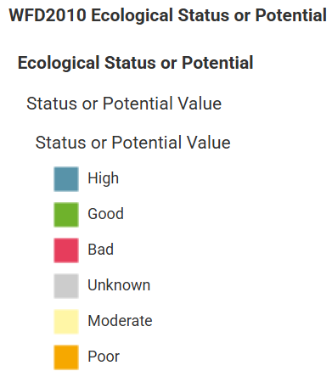
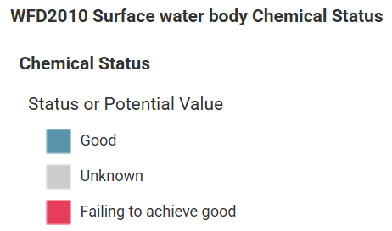
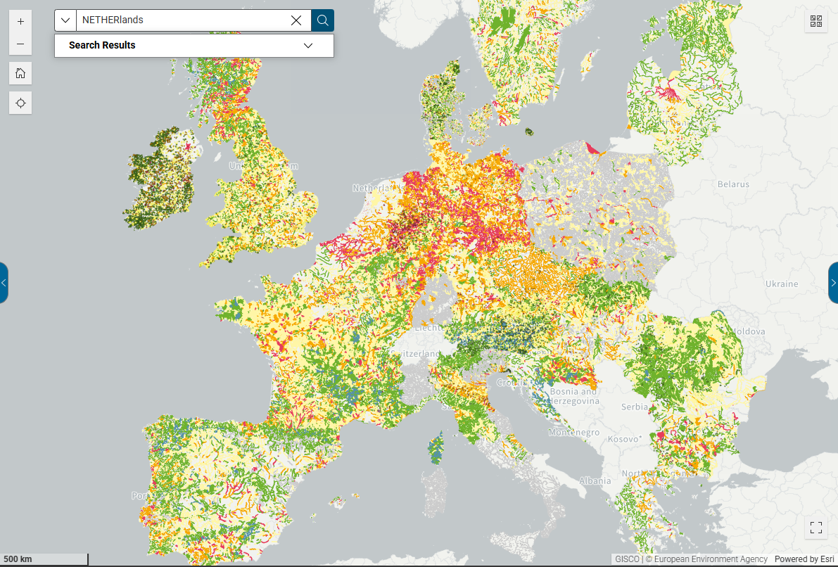
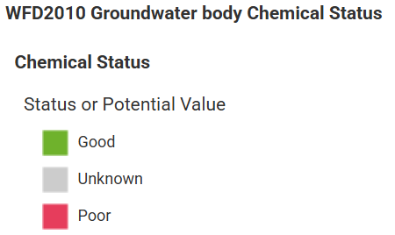
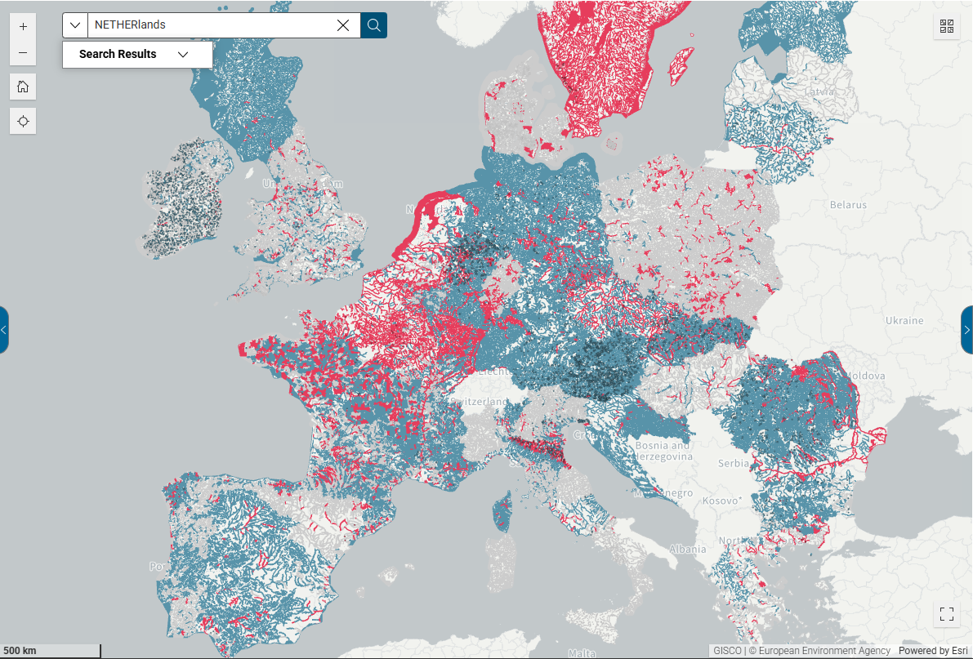
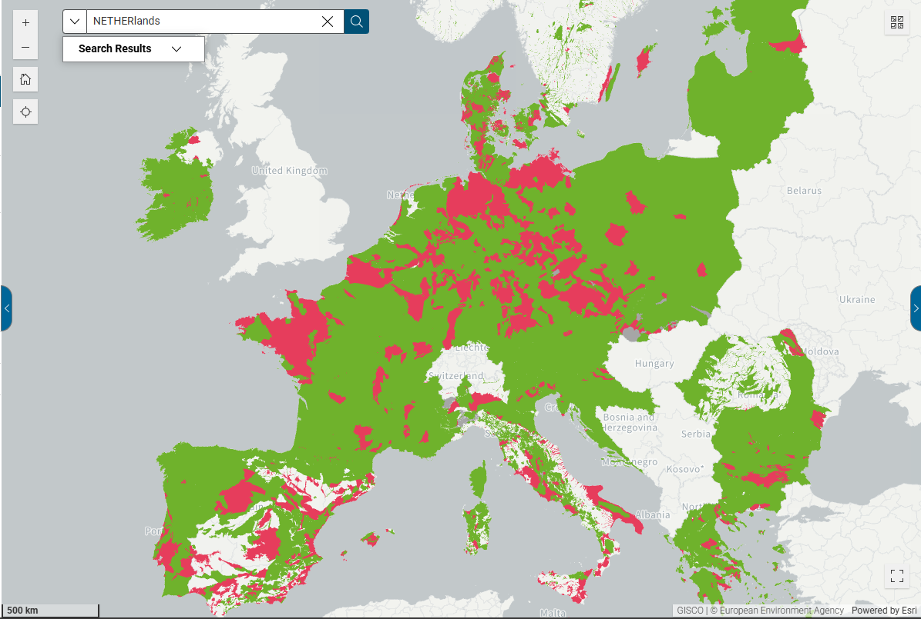
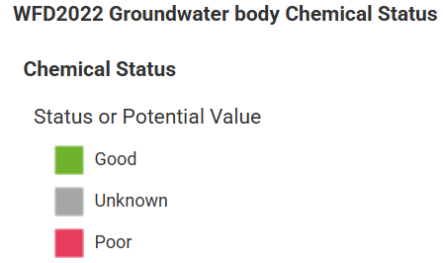
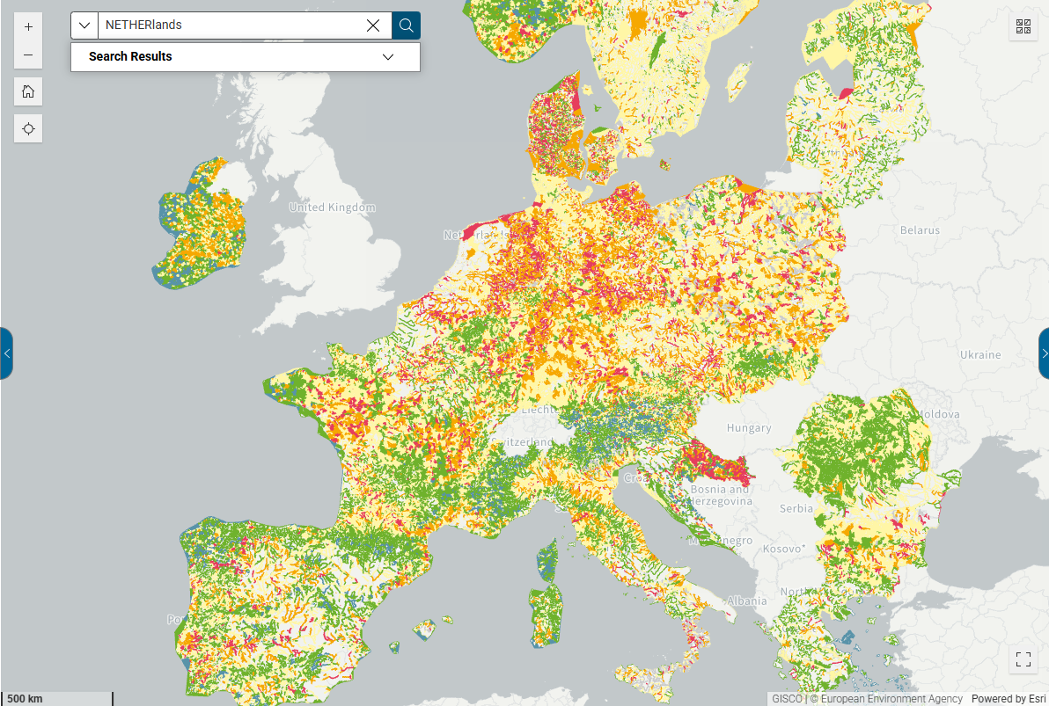
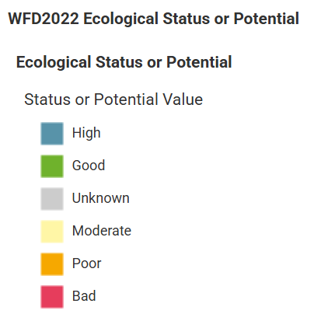
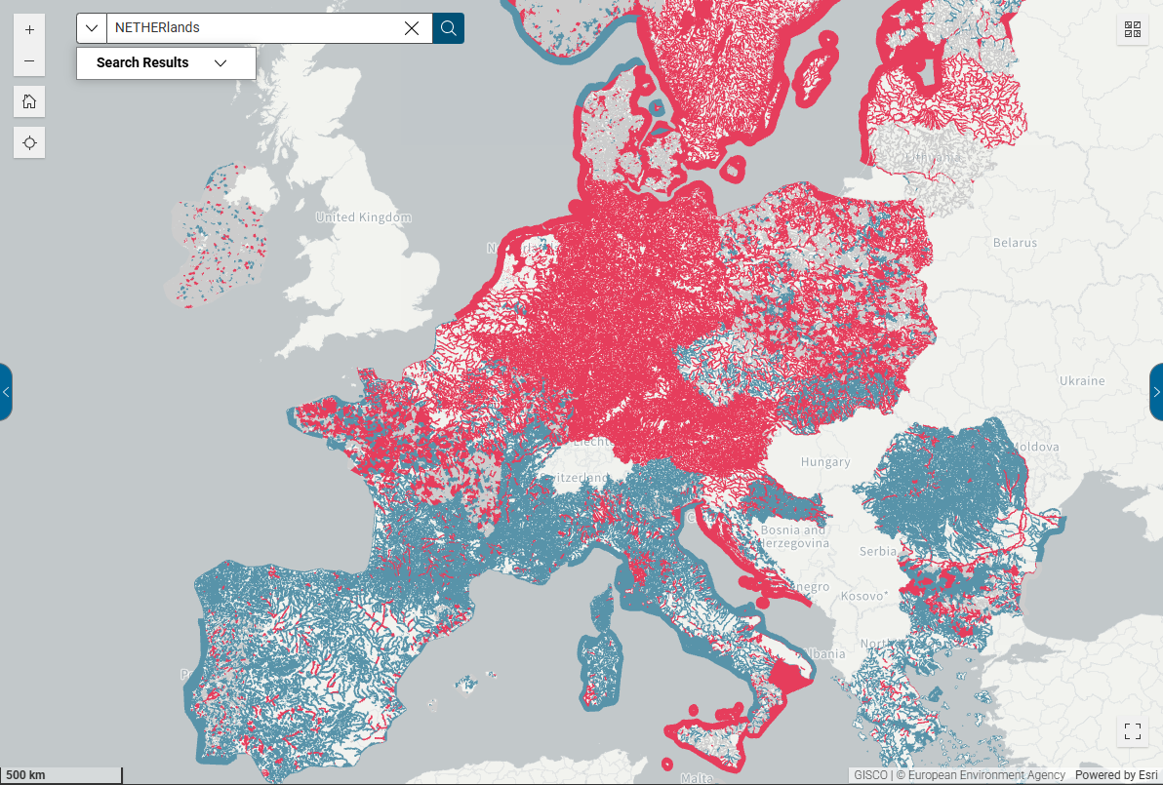
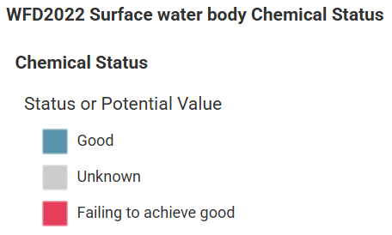
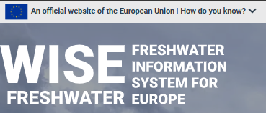
The ecological Status relates (in)direct to ground water quality (chemical) in normal (2010) and dry (2022) years as opposed to surface water quality in dry periods like in 2022 (see lower right in 2022)

Slide 8
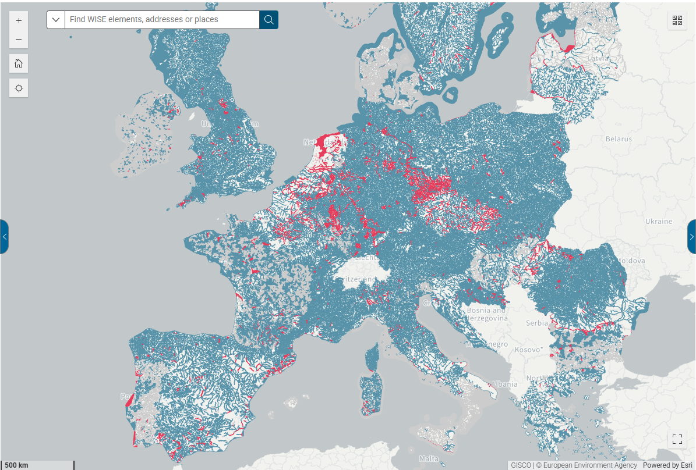
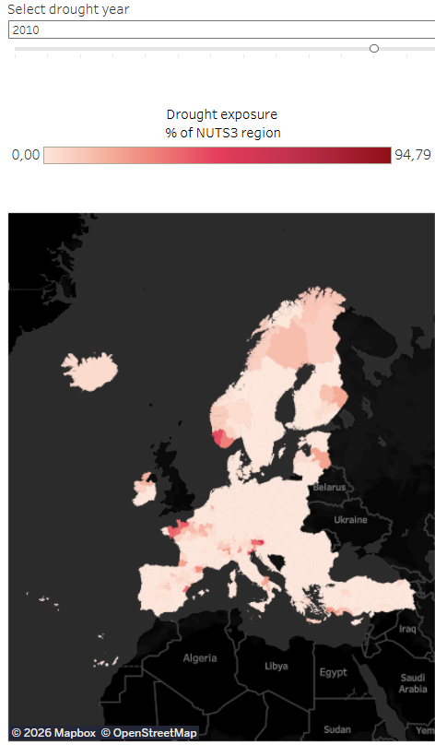
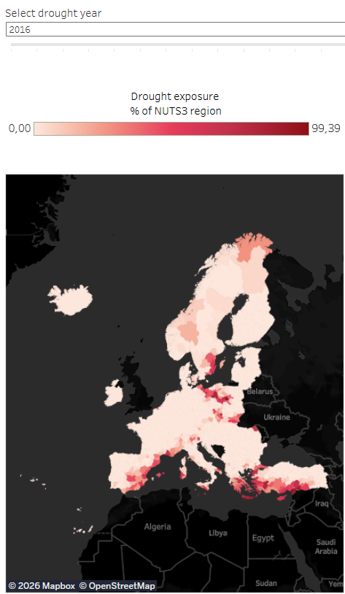
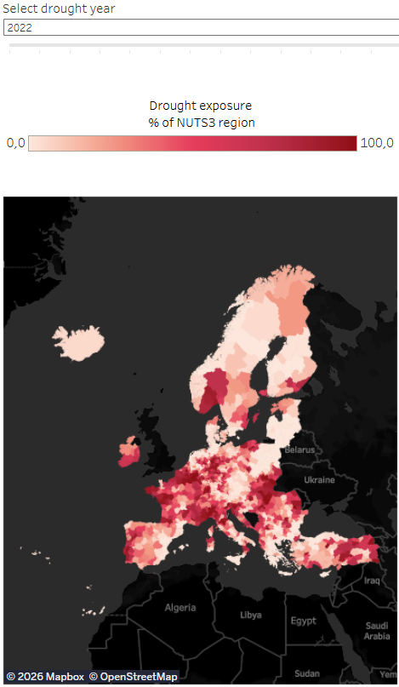
Respective (chemical) water quality in year 2010, 2016 and 2022 and the correlation with drought by soil moisture deficit
Soil Moisture Deficit (SMD) refers to the amount of water needed to bring the soil back to its field capacity
However ...
Water quantity:
in extreme dry periods (like in 2022) the soil moisture deficit in the profile (vadose zone) appeared to have an (in)direct effect on (surface) water quality in Central & N. Europe (see WFD/EEA website WISE Freshwater) not to be mixed up by our
PCP-WISE project !!!

Slide 9


For discussion:
A sound monitor of your basic soil-water-vegetation system conditions in quantitative terms is required to assess your water quality.

