Slide 1
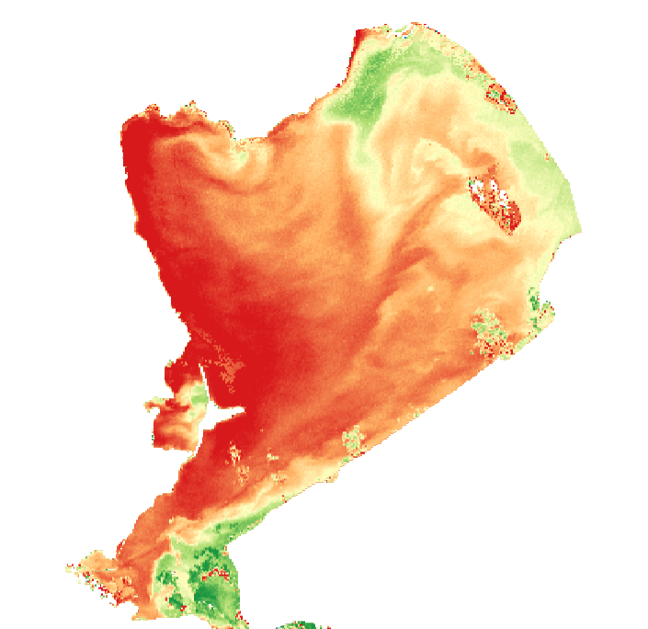

Remote sensing and
Water quality
A global EO-based water quality monitoring system
18 March 2026 | Water Workshop – Lightning talk
David Modiano | david.modiano@52impact.nl

Slide 2

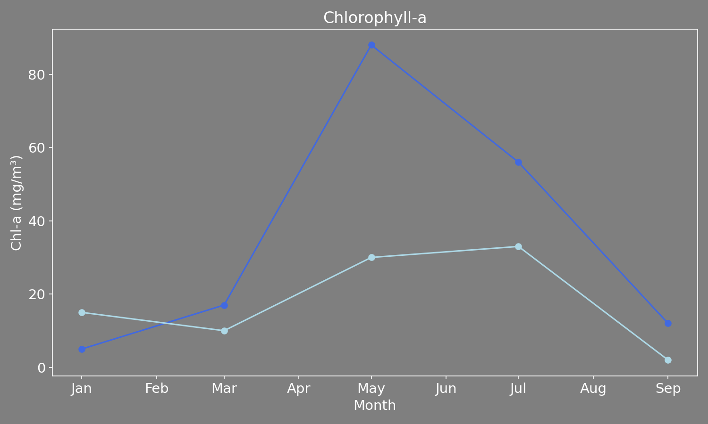
Context
Context and current challenges
Water quality affects ecosystem health, drinking water safety, and regulatory compliance. Water management organisations have the challenge of monitoring water quality with limited resources.
The monitoring gap
Sparse in time: monthly sampling misses rapid events
Sparse in space: point measurements can't capture whole-waterbody dynamics
Processing delays: lab turnaround can delay responses

Slide 3
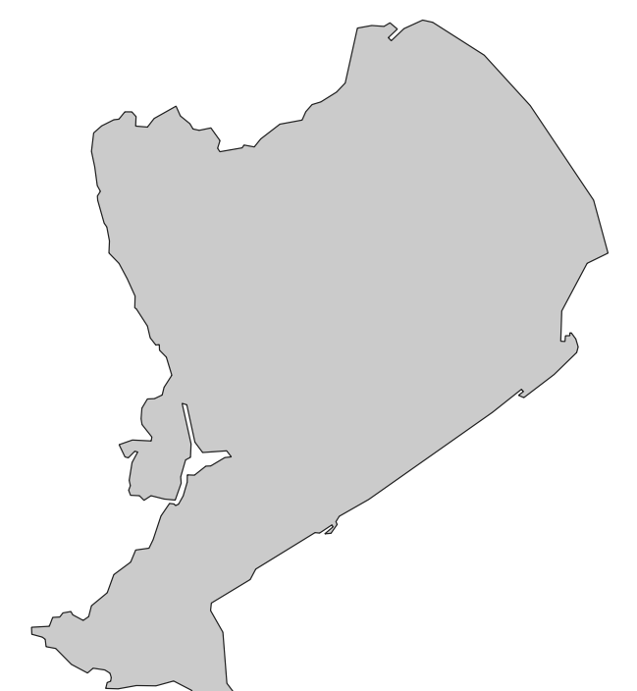
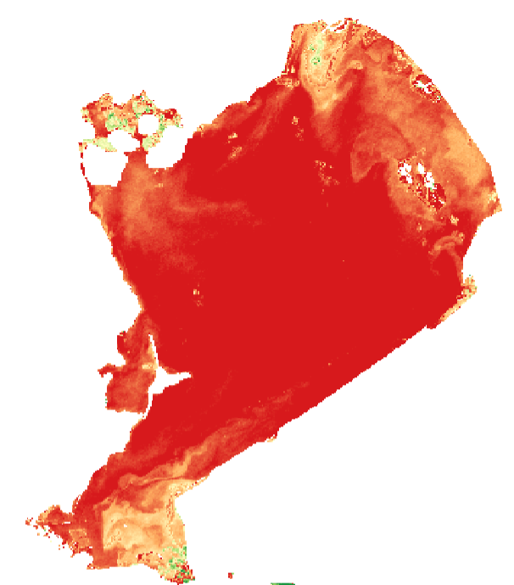
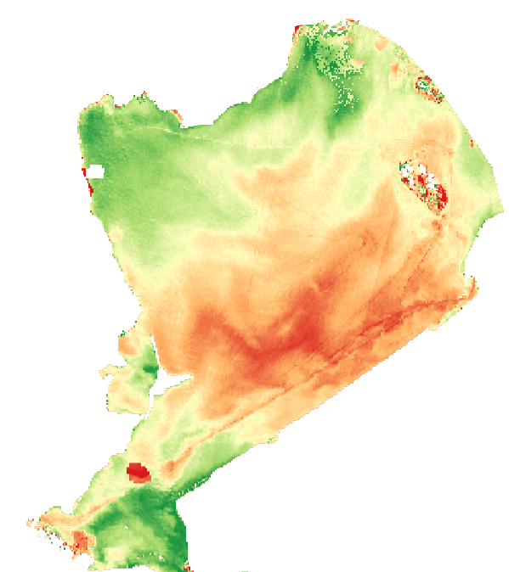
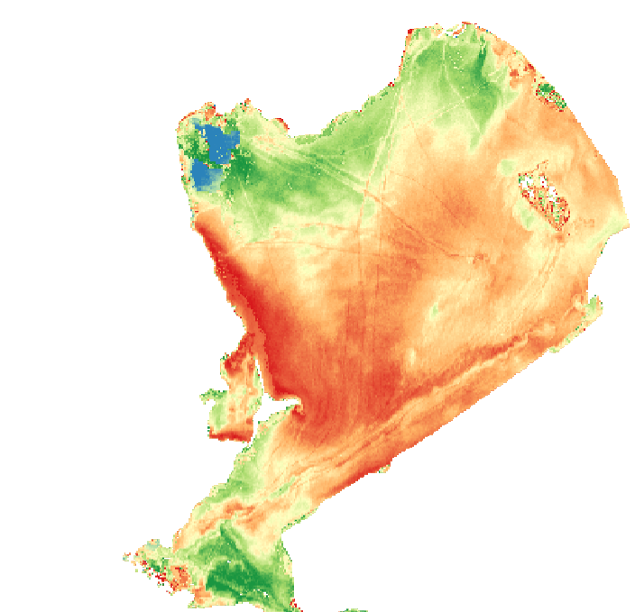
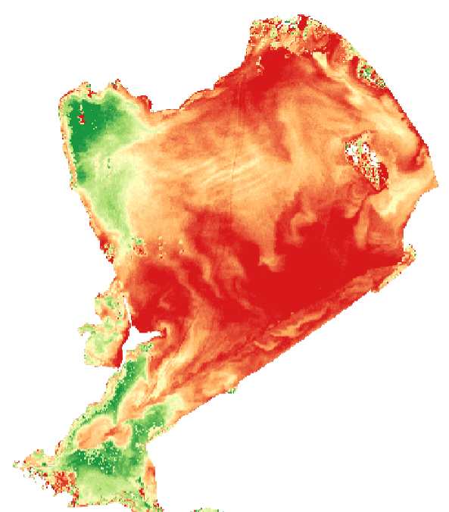
Context
Weeks / months
Days / weeks

Slide 4
Solution
What did we do?

Slide 5

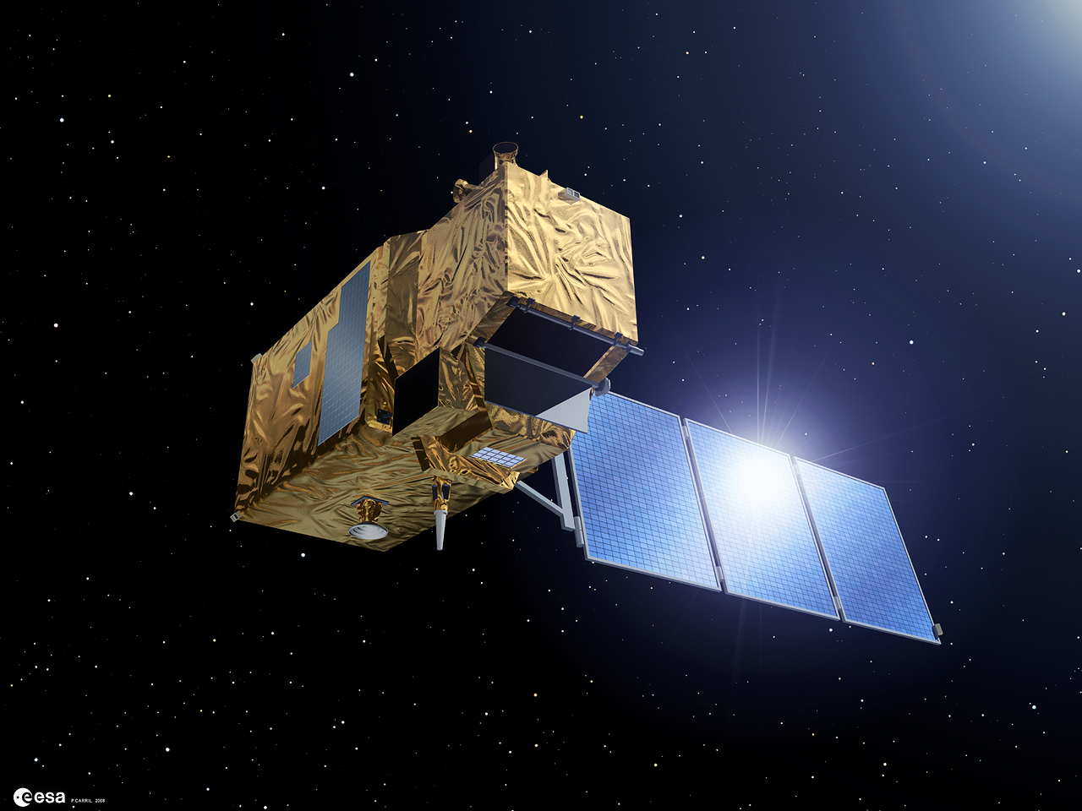

Solution
Sentinel2
Global coverage
Spatial resolution 10 meters
12 bands ~440 – 2200 nm
Temporal resolution up to 5 days
WaterWatch
With this context in mind, we developed a global Sentinel-2-based water quality monitoring tool - WaterWatch.
The goal is to build a globally applicable, EO-based application that can, by complementing in-situ data, help water management entities in both the public and private sectors make informed decisions regarding water quality.
The primary dataset used for model development are multispectral images from Sentinel-2, and water quality information is derived from custom models.
Input
Ensemble model
Output
Markermeer
Relative (0-1) estimates of Chlorophyll-a per image
Water body
Chlorophyll-a
Parameter

Slide 6

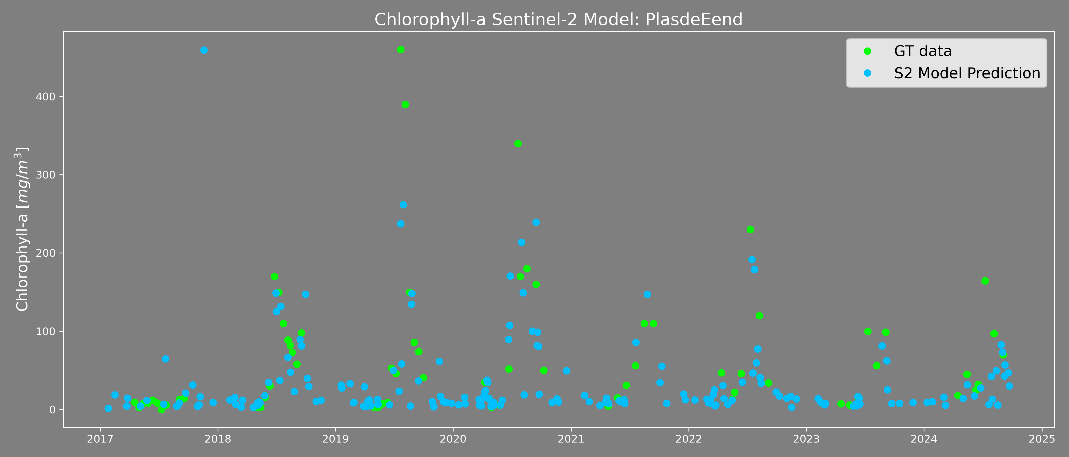
Solution
Monitor water quality more frequently without an additional need for visiting lakes.

Slide 7


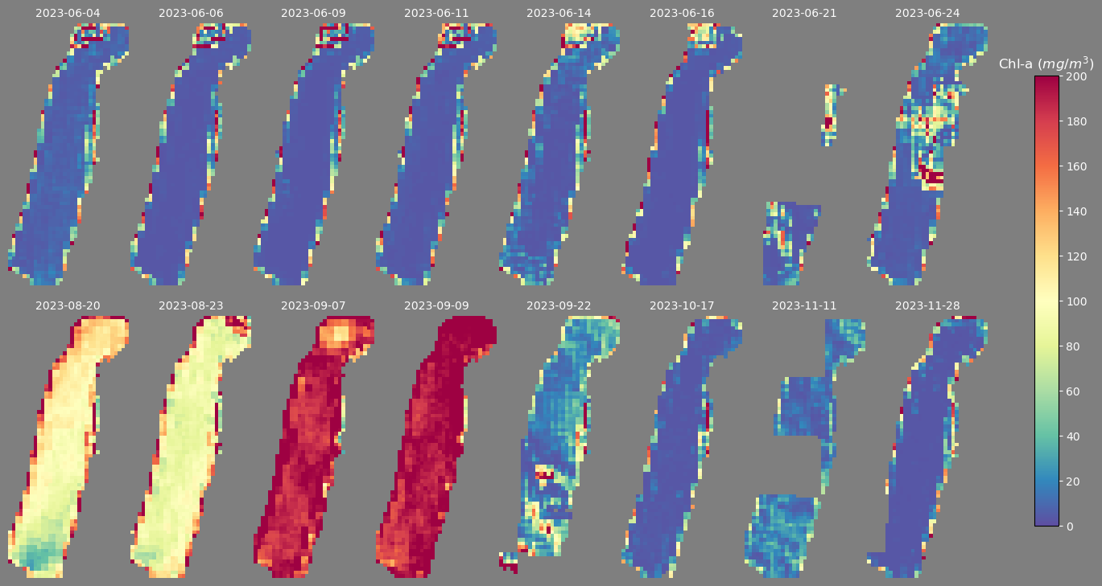
Solution
Monitor water quality more frequently without an additional need for visiting lakes.
Pinpoint the specific days and locations in which significant water quality changes occurred.

Slide 8

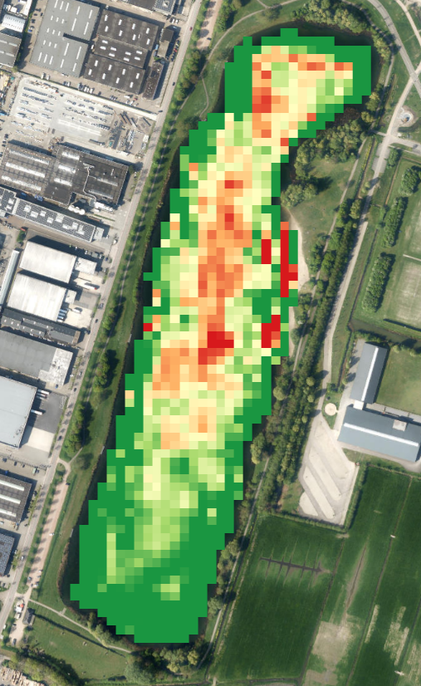

Solution
Monitor water quality more frequently without an additional need for visiting lakes.
Pinpoint the specific days and locations in which significant water quality changes occurred.
Know which areas experience dangerous water quality issues, even when in-situ measurements do not occur.

Slide 9
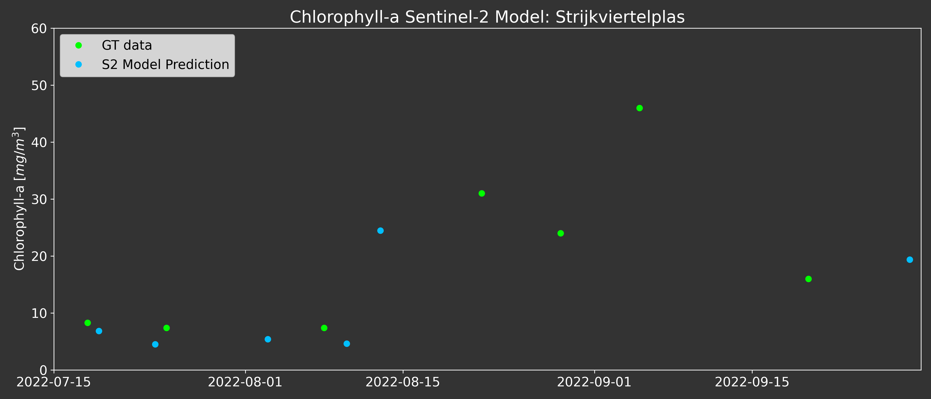


Solution
Monitor water quality more frequently without an additional need for visiting lakes.
Pinpoint the specific days and locations in which significant water quality changes occurred.
Know which areas experience dangerous water quality issues, even when in-situ measurements do not occur.
9 days
Receive timely notifications of dangerous increases in algae within one day of detection.

Slide 10
Applications
Who is this for?

Slide 11



Applications
Public water management organisations
Water boards
Provinces
Government-level entities
Any entity reporting through WFD
Notes:
Swimming alerts, water quality reporting

Slide 12
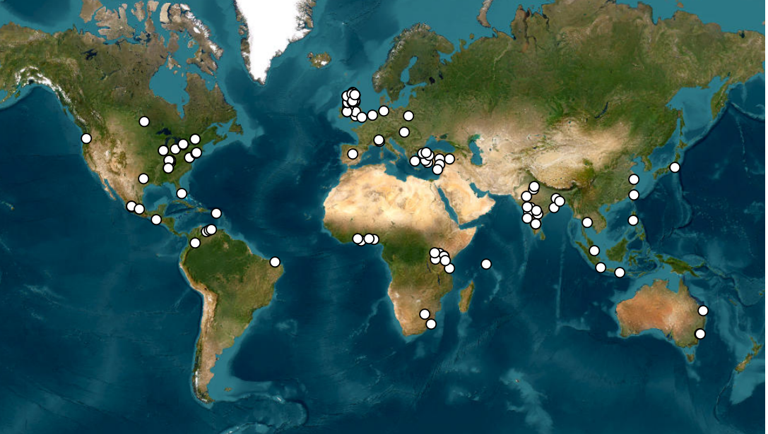
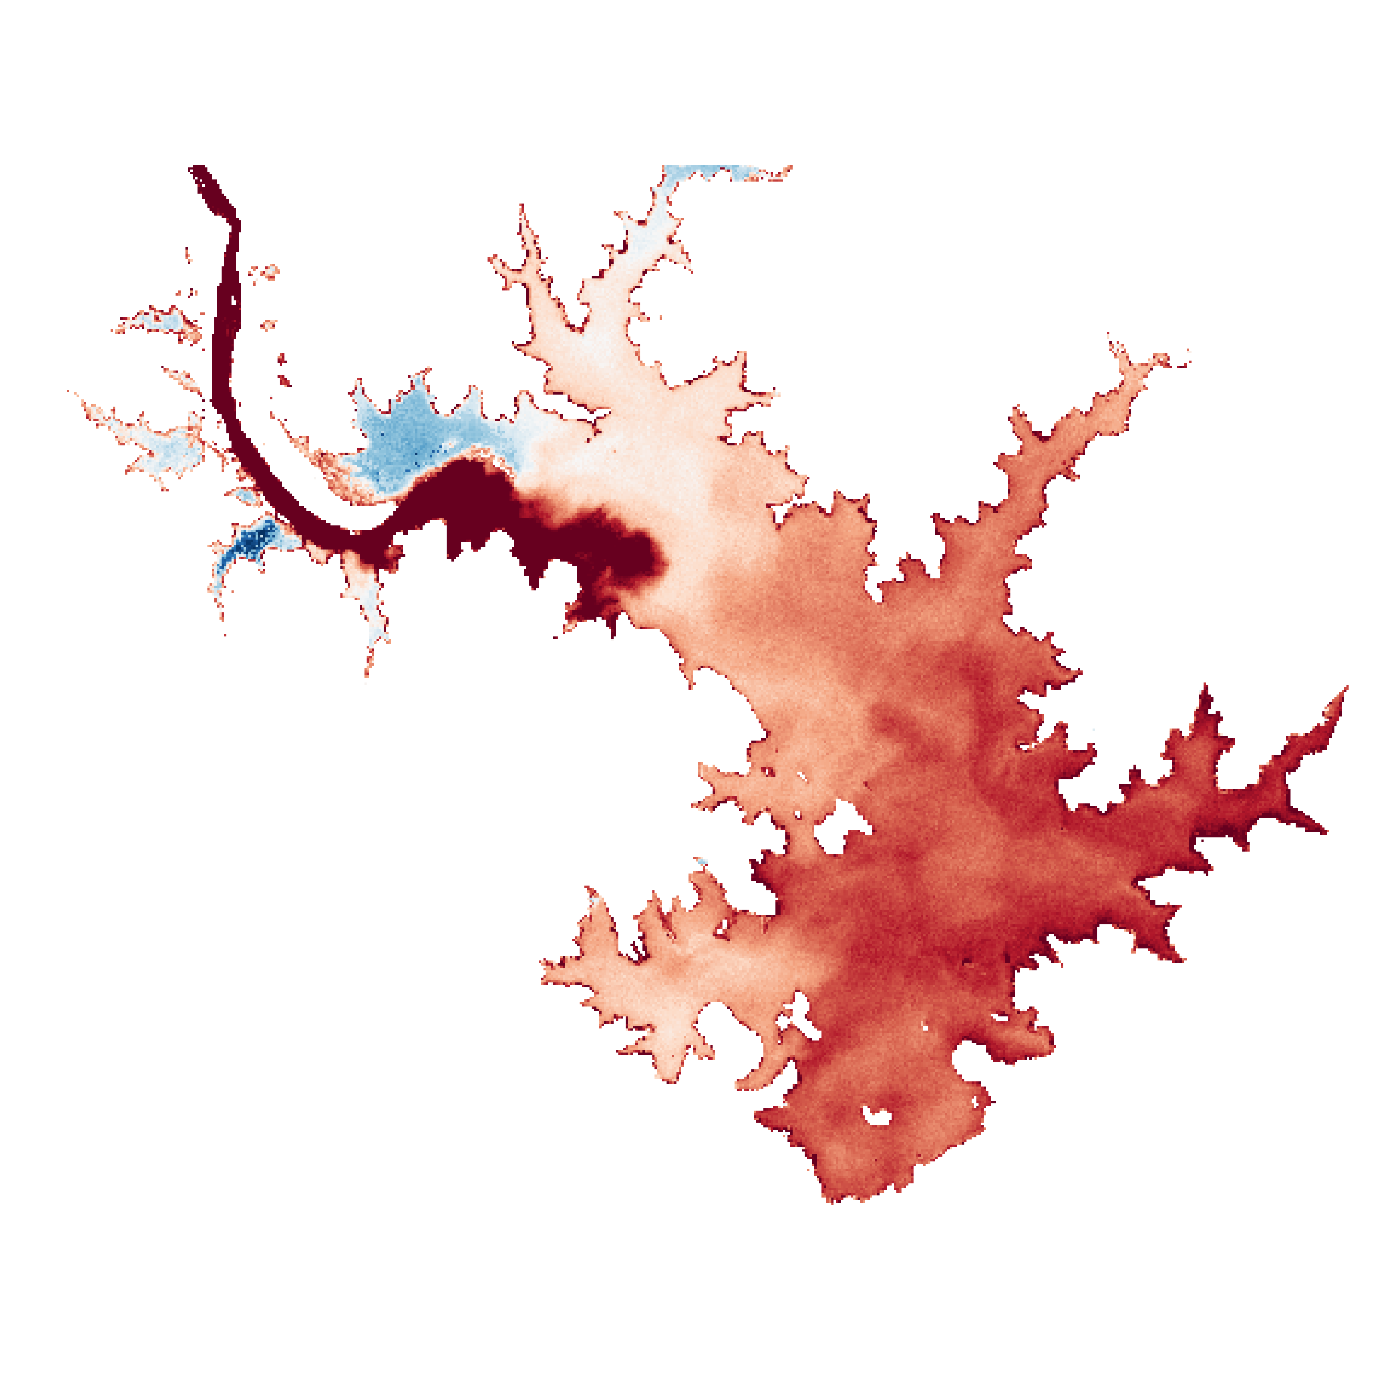
Applications
Private entities with water quality needs
Food and beverage industry:
  Companies with water quality impacts
  Companies with water quality dependencies

Slide 13
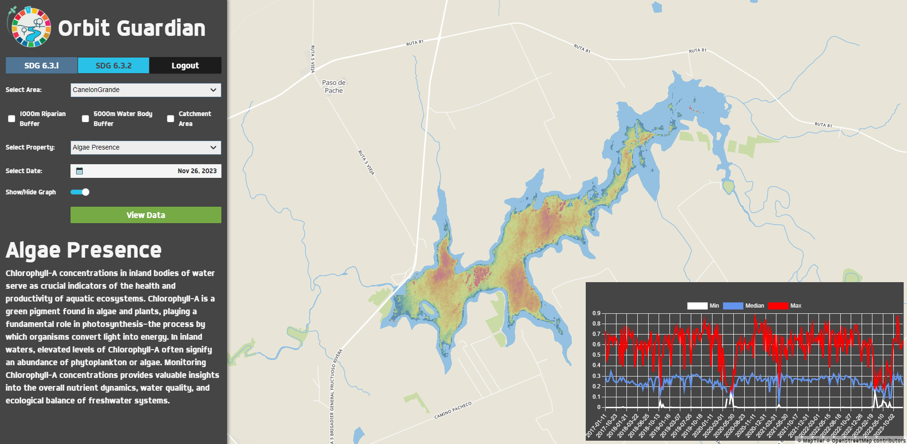
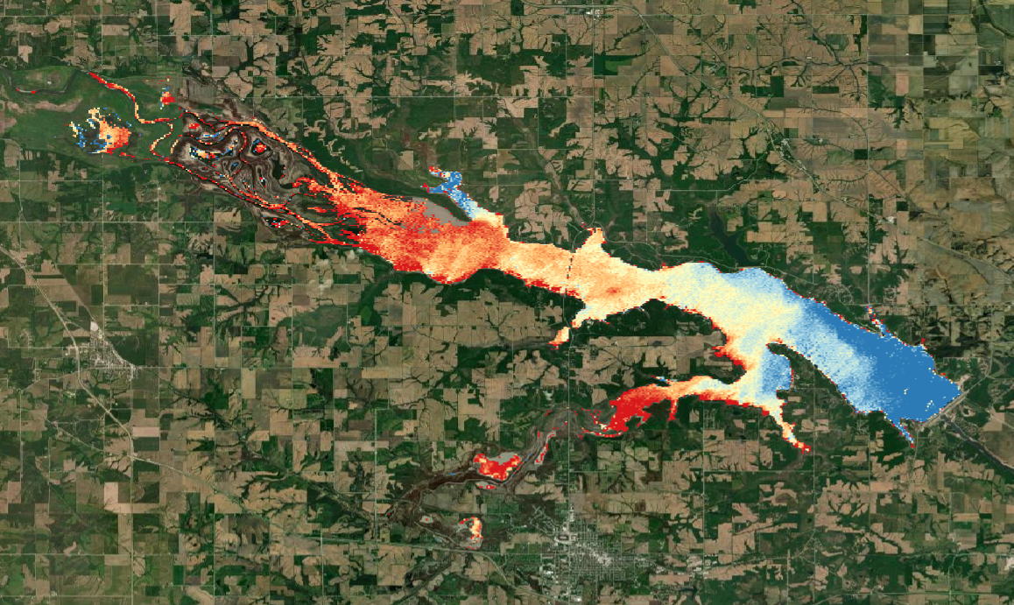
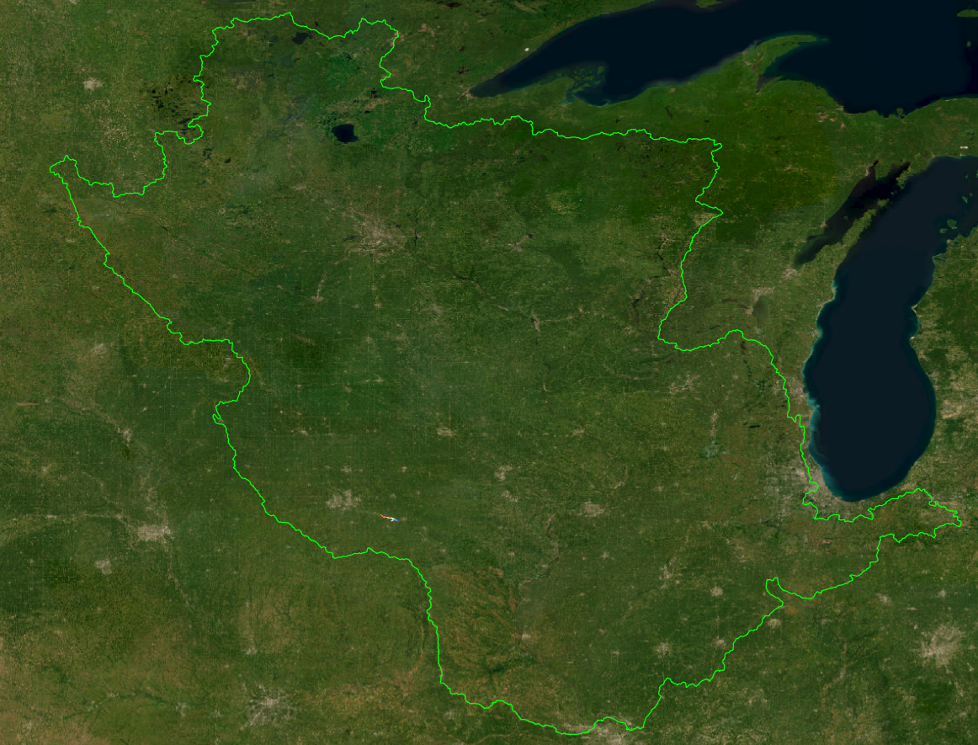

Applications
ESA: Research and application development
Orbit Guardian
ESA project, in collaboration with S&T, aims to assist countries in monitoring and improving their water resources by providing a comprehensive EO-based platform for water quality assessment. The project was designed to support countries in accomplishing SDG 6.3 sub-indicators.
Pilot work was undertaken in Uruguay, Sierra Leone, and Jamaica.
BasinMeter
Partnership with NGOs and ESA to build a global basin health monitoring system with water quality as one of the indicators.

Slide 14
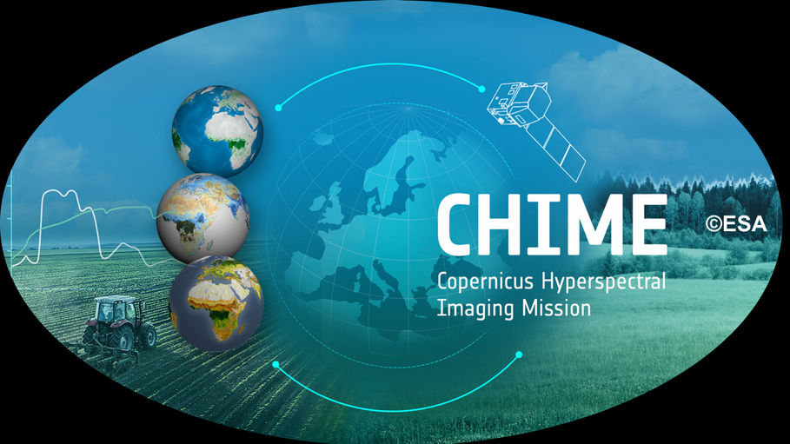
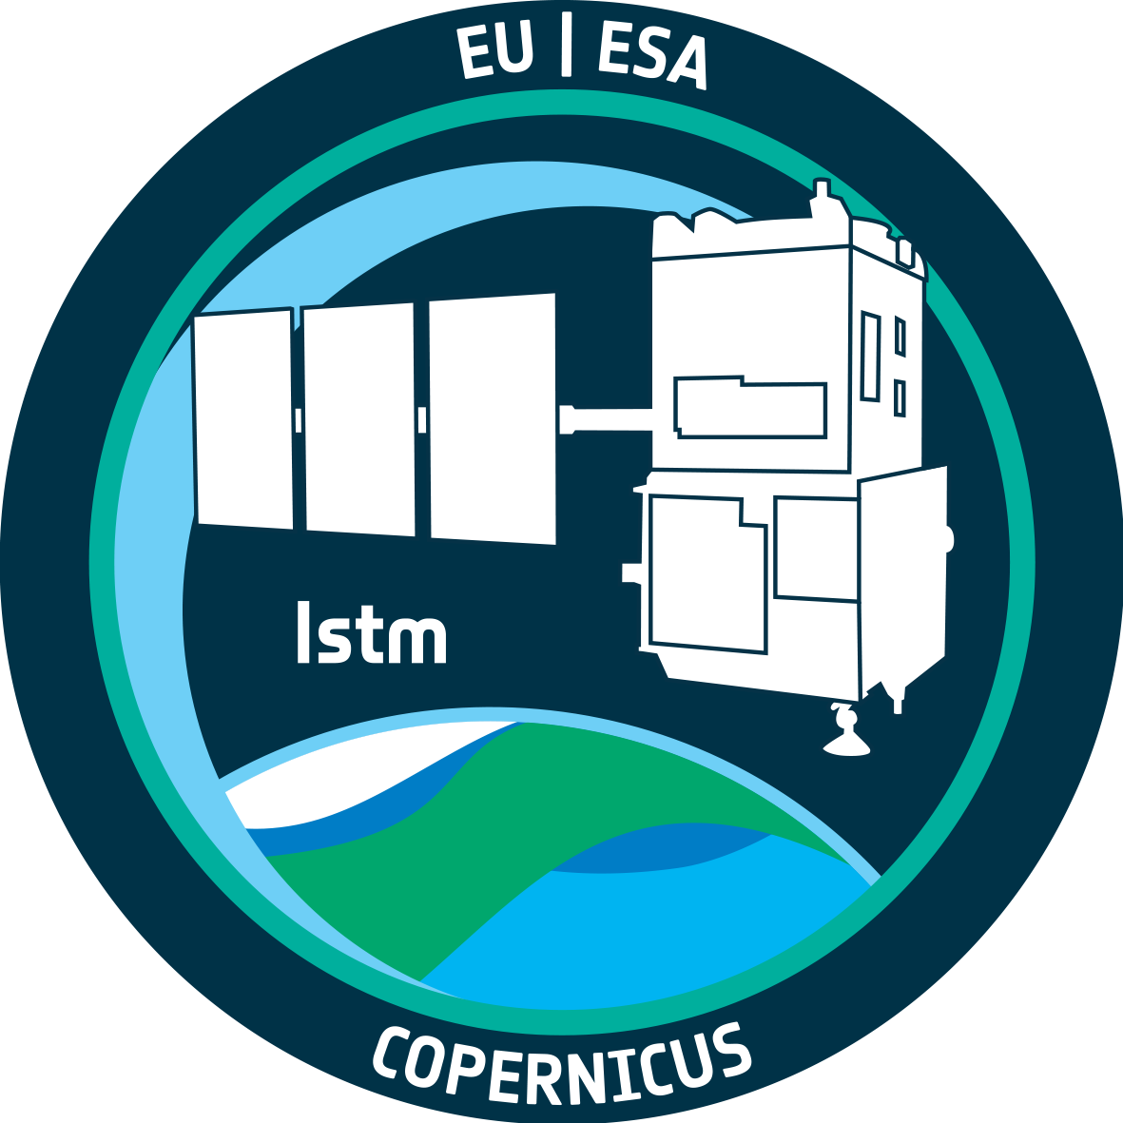
Applications
ESA: Research and application development
52impact is collaborating with the University of Stirling, Deltares, and GeoEcoMar on an ESA Sentinel Users Preparation project ANACONDA.
One of the key goals is to simulate datasets of future ESA missions and build EO-based water quality applications on top of existing Sentinel-2-based tooling.

Slide 15
Applications
Thank you

