Slide 1
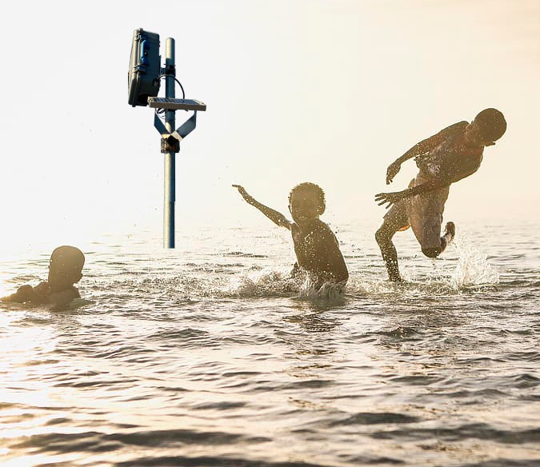






Water Insight
New and ongoing
www.waterinsight.nl
info@waterinsight.nl

Slide 2
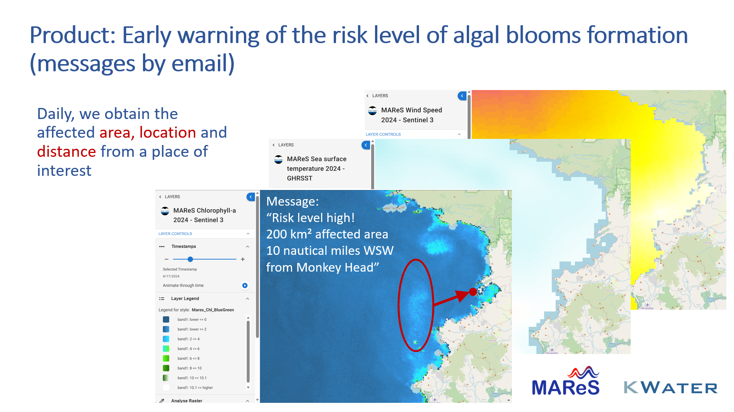
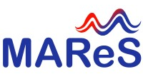
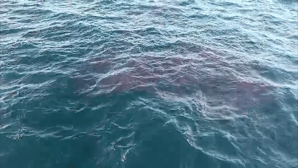
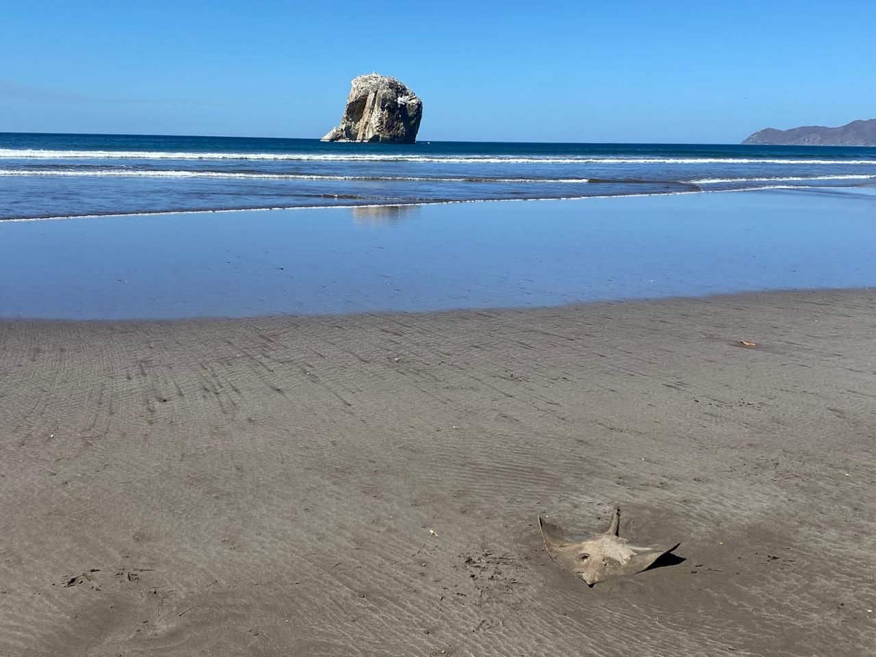
Partners for Water
Harmful algal bloom early warning service in Costa Rica

Slide 3
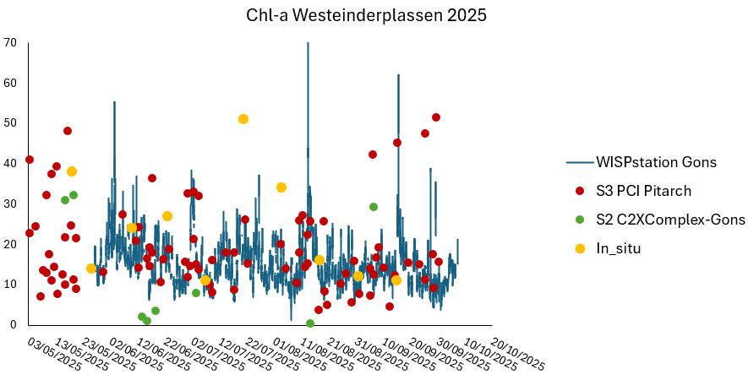
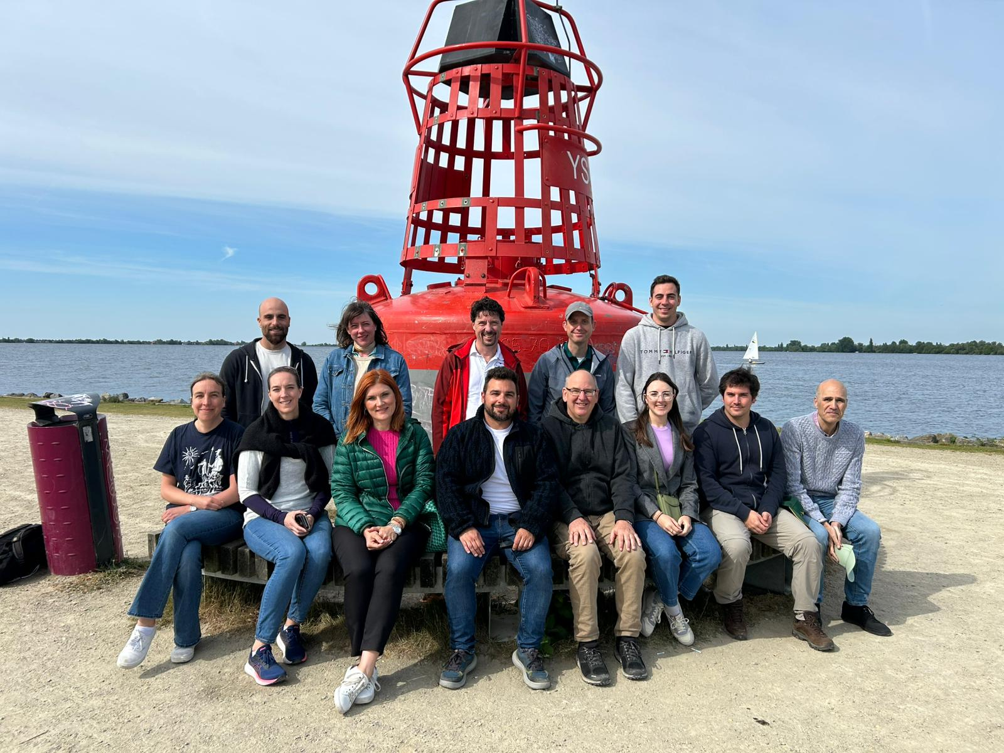
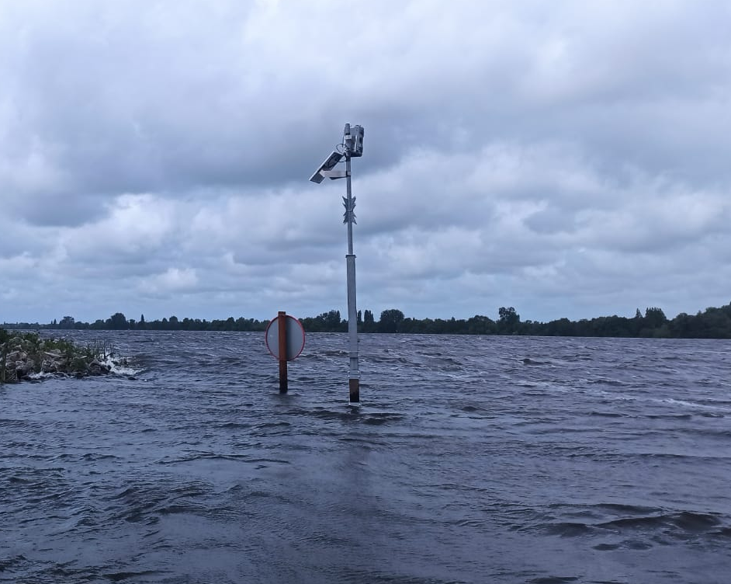

EU LIFE CYANOBLOOM
Improved monitoring of cyanobacterial risks with:
WISPstation
Satellite imagery
Samples of toxins
Case study site at Westeinderplassen

Slide 4



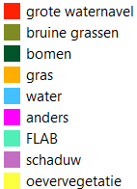
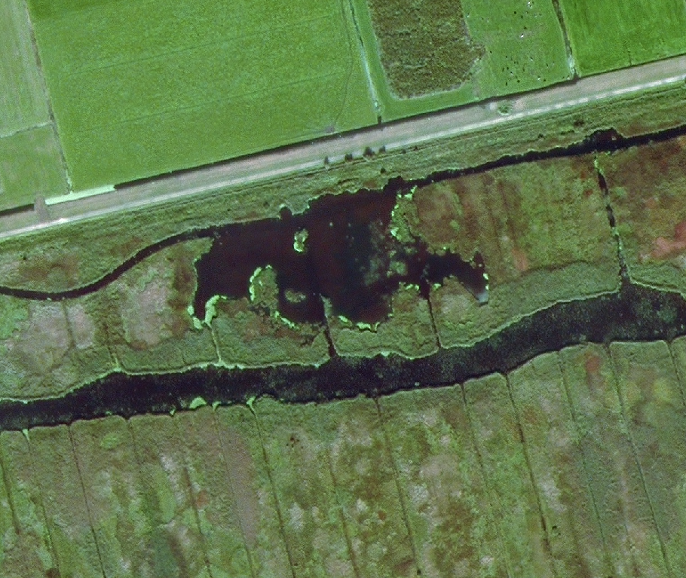
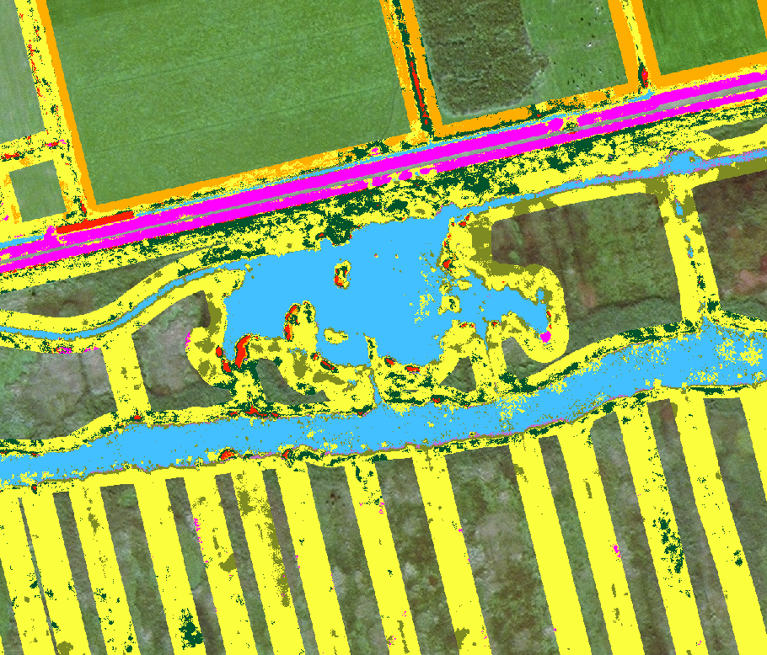
Aquatische vegetation monitoring in NL
HH Delfland (with R. Haskoning)
Waterschap Noorderzijlvest
Waterschap Hollandse Delta

Slide 5
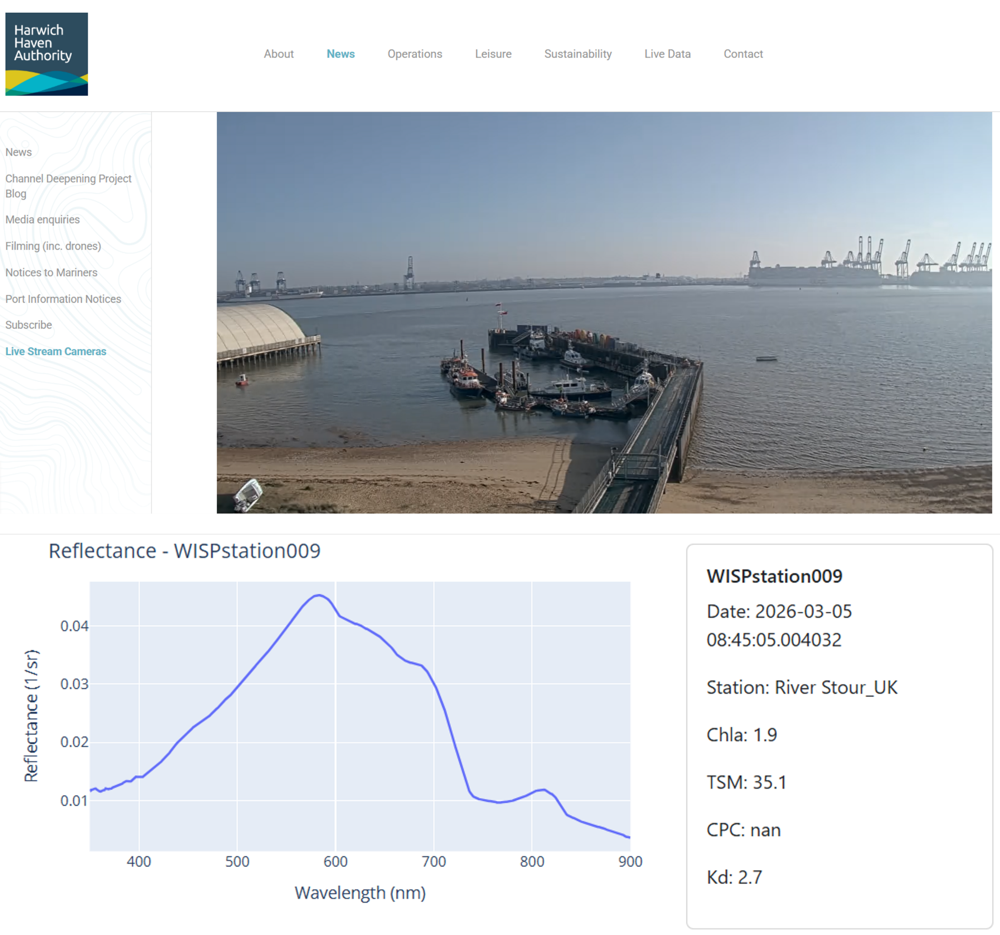

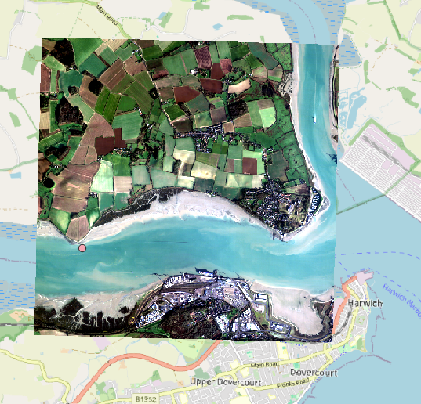
ESA BASS TRACTIONS
Dredging and sediment release monitoring for port authorities
Atmospheric correction based on in situ WISPstation data
High resolution temperature mapping

Slide 6
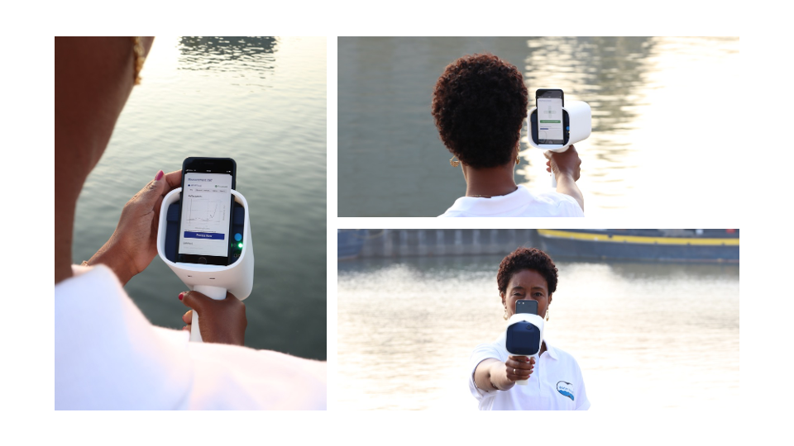
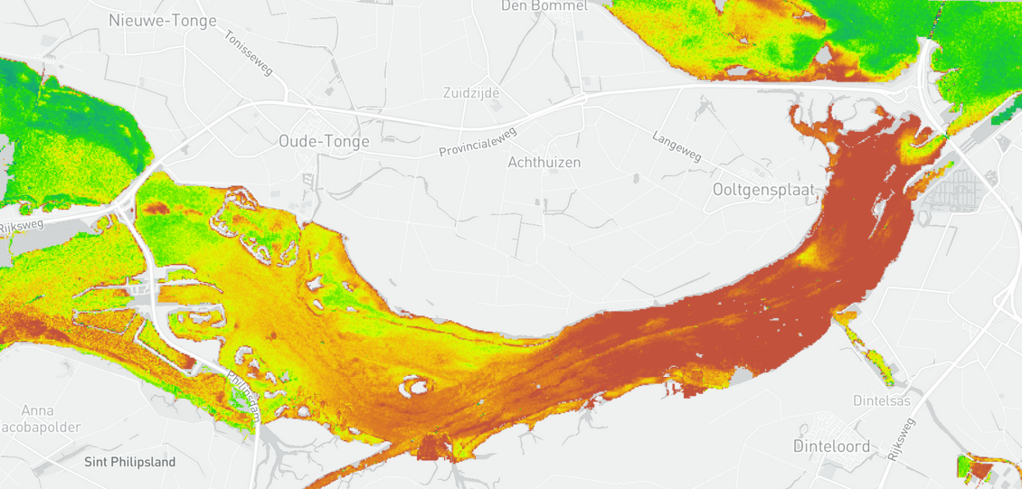
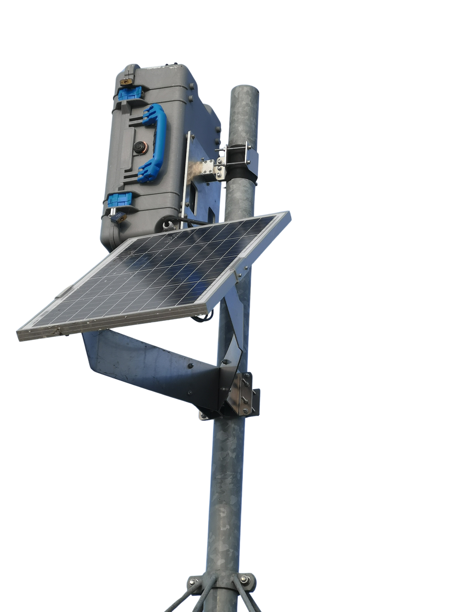
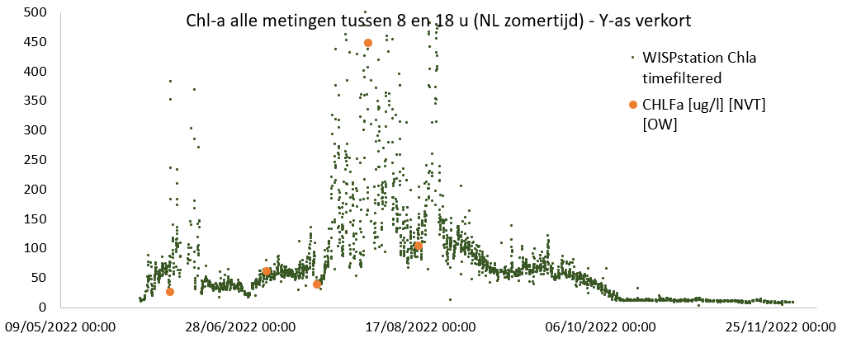
Instruments
23 augustus 2023
New! Hand-held WISP Orca
WISPstation
WISPstation versus laboratorium metingen

Slide 7
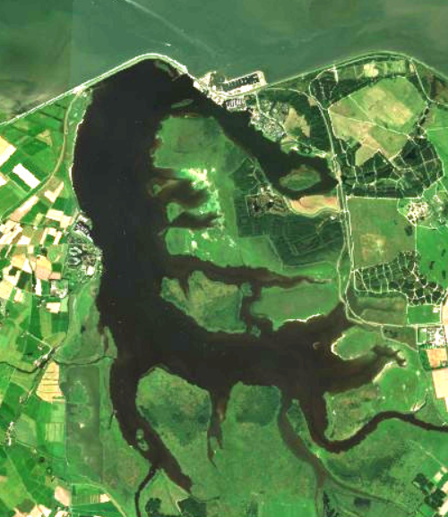
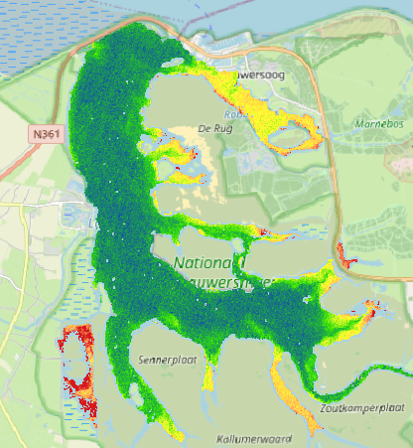
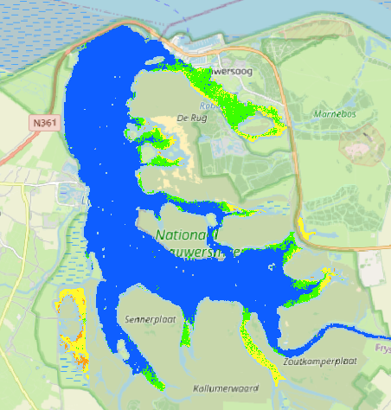

Interesse: Kaderrichtlijn Water
‘Lobbyen’ voor toestaan van het gebruik van satellietdata voor KRW:
Ruimtelijk inzicht in processen geeft veel meer mogelijkheden tot effectieve maatregelen
Evaluatie maatregelen
RGB
Chl-a
WFD
WI is ook actief pleitbezorger voor toestaan nieuwe meettechnieken in blauwalgenprotocol
Sentinel benefits studies: Water quality monitoring in the Netherlands
White paper Satellite-assisted monitoring of water quality to support the implementation of the Water Framework Directive
Aardobservatie voor waterkwaliteit in opdracht van IenW

Slide 8

















OASIS – Observation & AI-powered System for Intelligent Water Solutions
Almost starting: EU Horizon OASIS
G. A. 101293392 OASIS
Notes:
Horizon Europe funded 2026-2029; 7.5M Euros
Objective: Deliver Next Generation Services to support main aspects of Water Resiliency and Water Cycle Management
Utilises Co-Design with Stakeholders, AI/ML technology for harnessing Earth Intelligence
Aligns with the GEO Post-2025 work programme goals, with feature engagement with GEO AquaWatch and UNEP and sharing solutions at EUROGEO.

